Slide 1
09: Texture Parametrisation, Synthesis & Morphing

Slide 2
Texture Parametrisation
Assume you don’t have u,v coordinates
For example, when beginning modelling
Genus 0 is a sphere – use cartography
Genus 1 is a torus – double wraparound
Higher genus is more complex

Slide 3
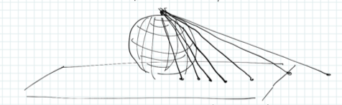
Spherical Parameterisation
Place sphere on the texture plane
Draw ray from N Pole through each point p
Find u,v coordinates at intersection w/ plane
N Pole maps to infinity w/ bad distortion

Slide 4
Spherical Parameterisation
Latitude / Longitude
Distorts infinitely near both poles
Interpolation becomes a problem
From wikipedia

Slide 5
Cube Map
From Epic Games forum
Use half of the texture space
Often used for skyboxes
But limits distortion

Slide 6
Practical Parameterisation
Separate surface into connected components
Separate each surface into patches
Pay an artist to assign u,v coords
Cut the surface into patches – i.e. artist
Expand random vertices until patches meet
Then assign u,v coordinates inside patches
But how?

Slide 7
An Example
Hormann, 2007 ACM (via Botsch et al.)

Slide 8
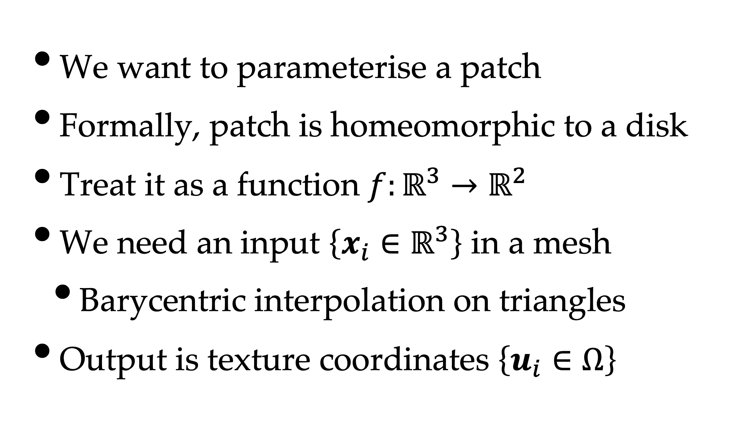
Assumptions
We want to parameterise a patch
Formally, patch is homeomorphic to a disk
Treat it as a function $f:ℝ^{3}→ℝ^{2}$
We need an input $\left\{x_{i}∈ℝ^{3}\right\}$ in a mesh
Barycentric interpolation on triangles
Output is texture coordinates $\left\{u_{i}∈Ω\right\}$

Slide 9
Theorem (Tutte, 1960)
Given a triangle mesh homeomorphic to a disk
We can enforce this with half-edge
With a convex boundary polygon
We can choose this
If the coordinates of each interior vertex are
A convex combination of their neighbours
Then you have a valid parameterisation

Slide 10
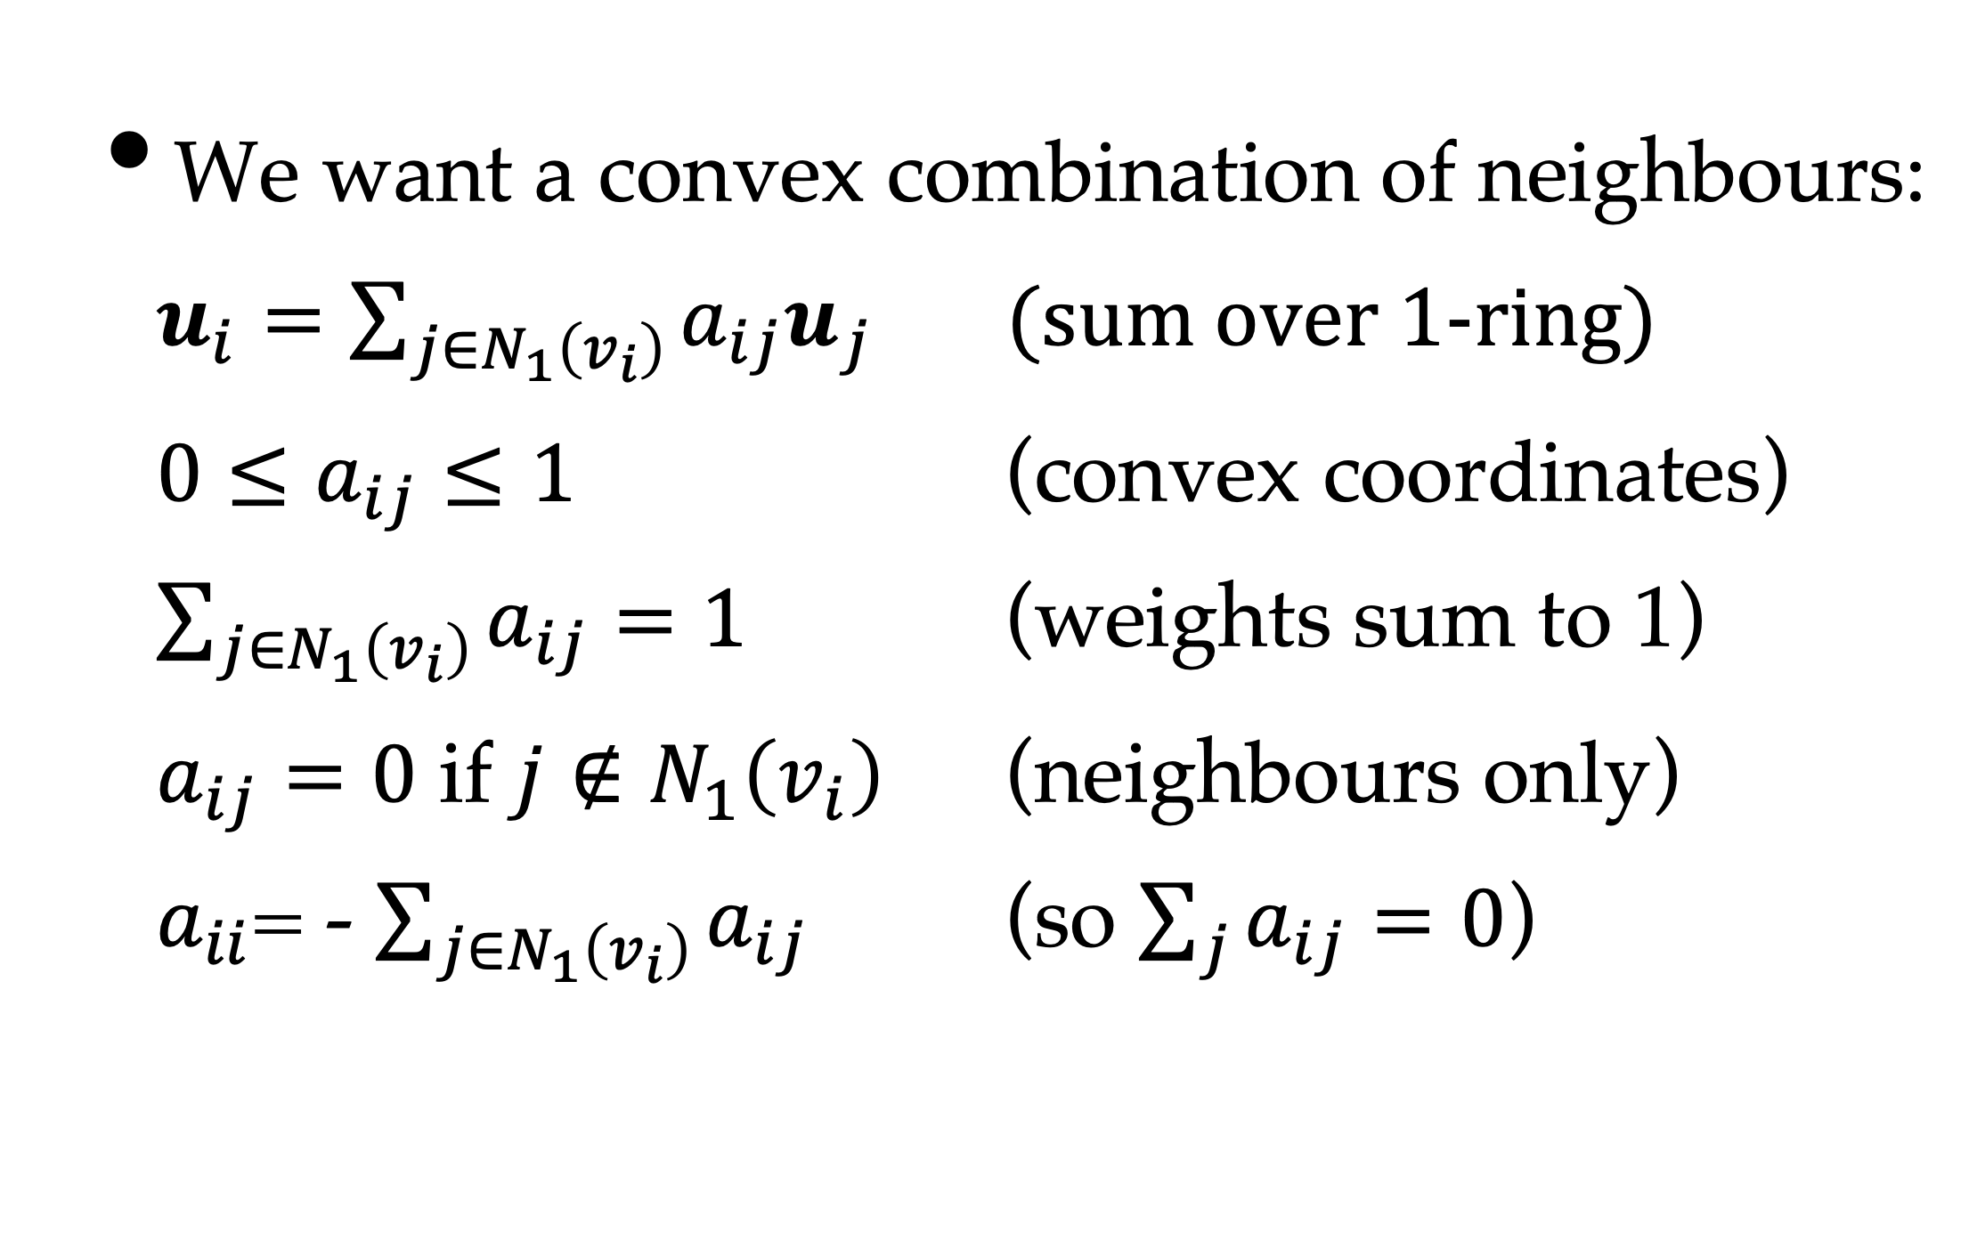
Setup
We want a convex combination of neighbours:
$u_{i}=\sum_{j∈N_{1}\left(v_{i}\right)}^{ }{{a_{ij}u}_{j}}$ (sum over 1-ring)
${0≤a}_{ij}≤1$ (convex coordinates)
$\sum_{j∈N_{1}\left(v_{i}\right)}^{ }{a_{ij}}=1$ (weights sum to 1)
$a_{ij}=0$ if $j∉N_{1}\left(v_{i}\right)$ (neighbours only)
$a_{ii}$= - $\sum_{j∈N_{1}\left(v_{i}\right)}^{ }{a_{ij}}$ (so $\sum_{j}^{ }{a_{ij}}=0$)

Slide 11
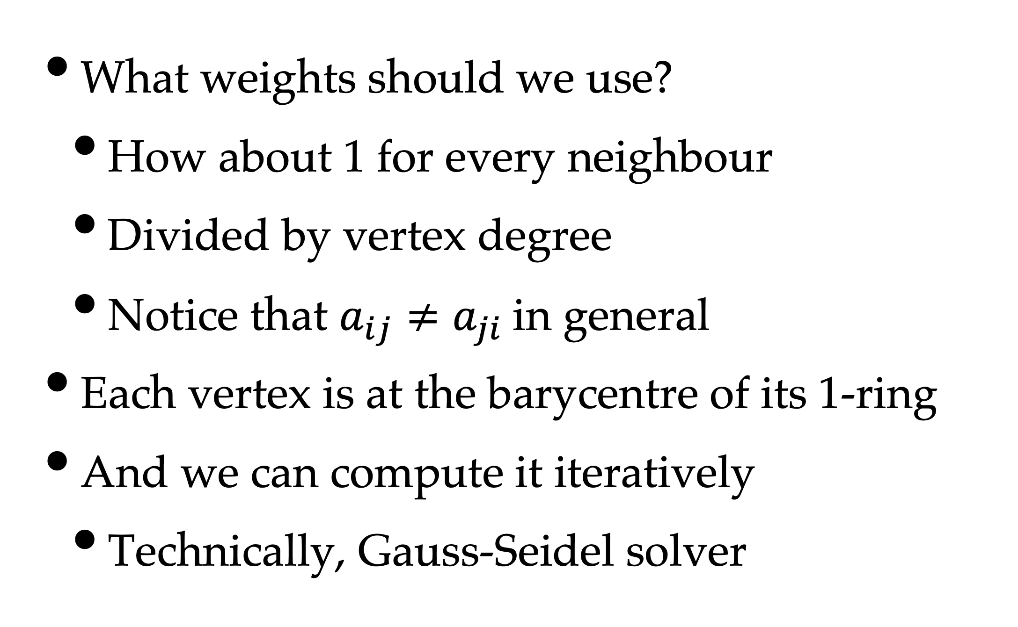
Setting Coefficients
What weights should we use?
How about 1 for every neighbour
Divided by vertex degree
Notice that $a_{ij}≠a_{ji}$in general
Each vertex is at the barycentre of its 1-ring
And we can compute it iteratively
Technically, Gauss-Seidel solver

Slide 12
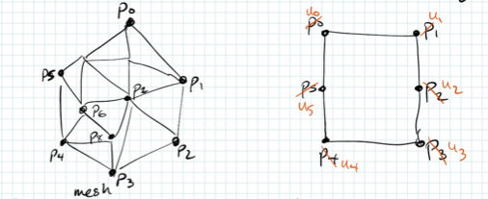
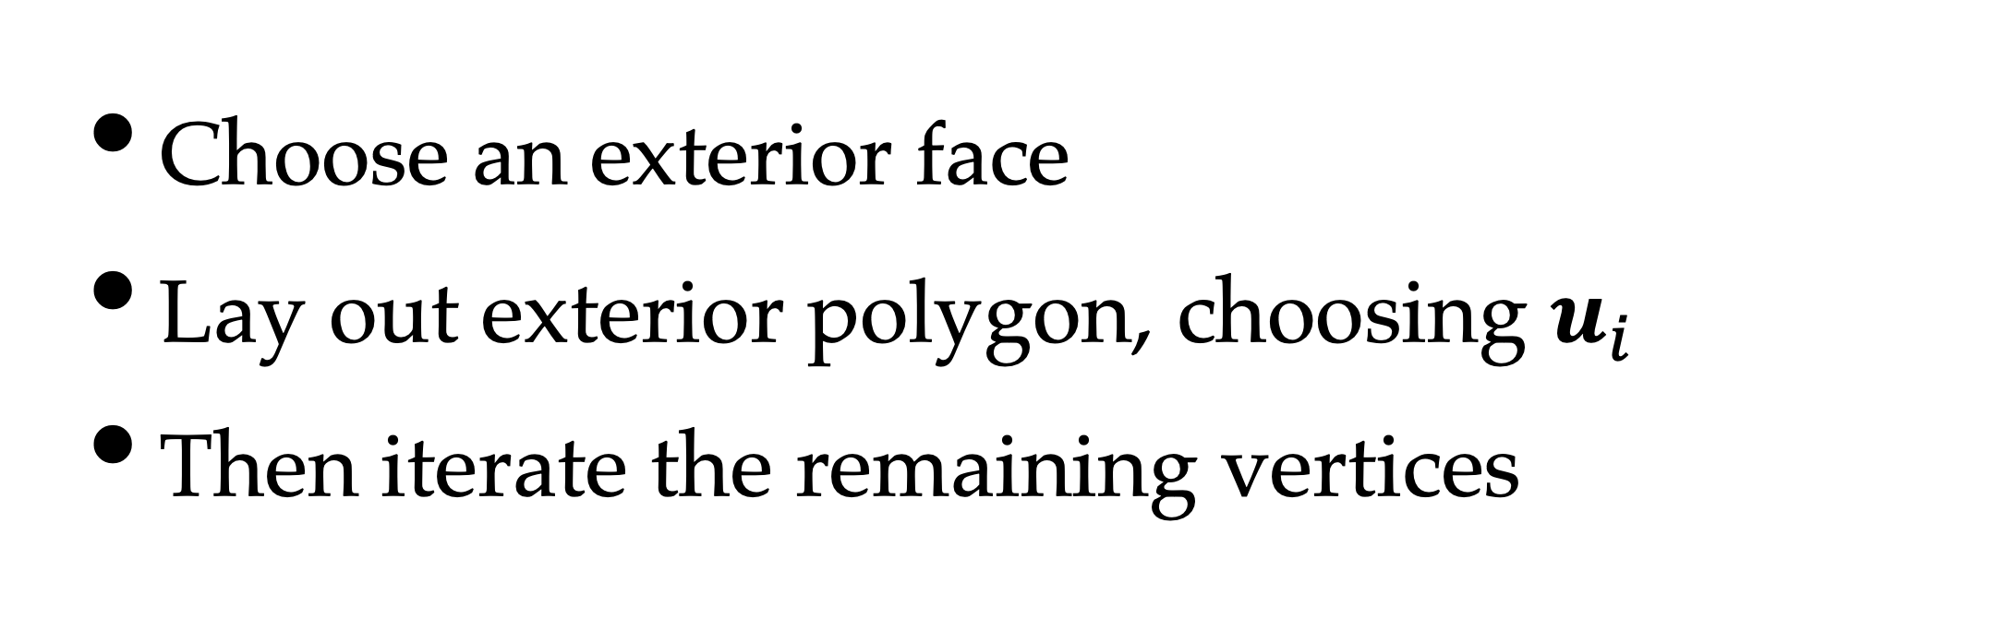
Floater’s Algorithm
Choose an exterior face
Lay out exterior polygon, choosing $u_{i}$
Then iterate the remaining vertices

Slide 13
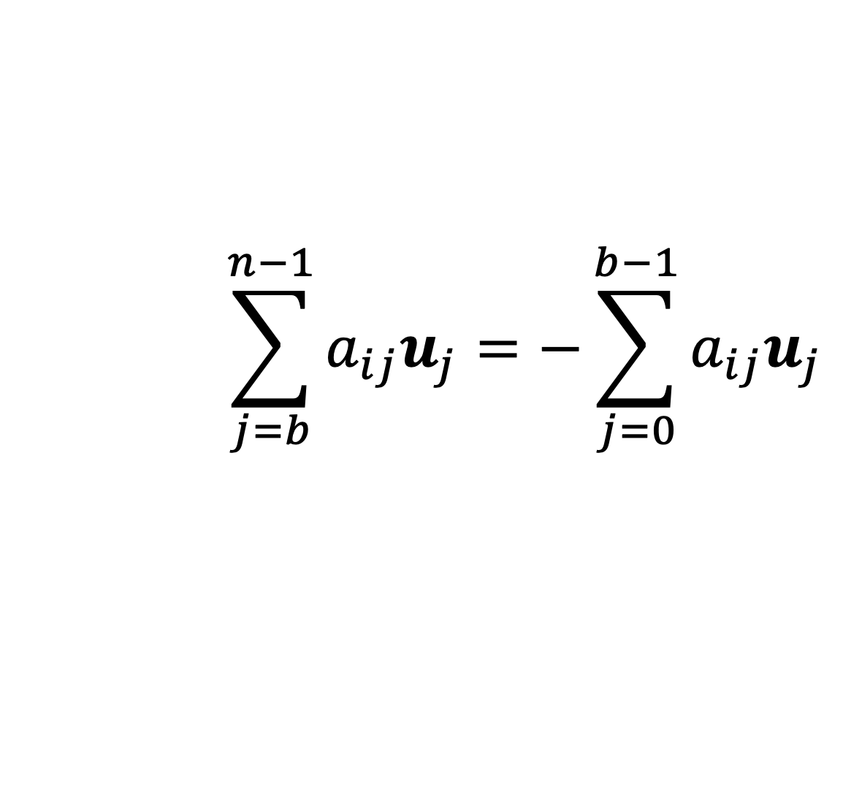
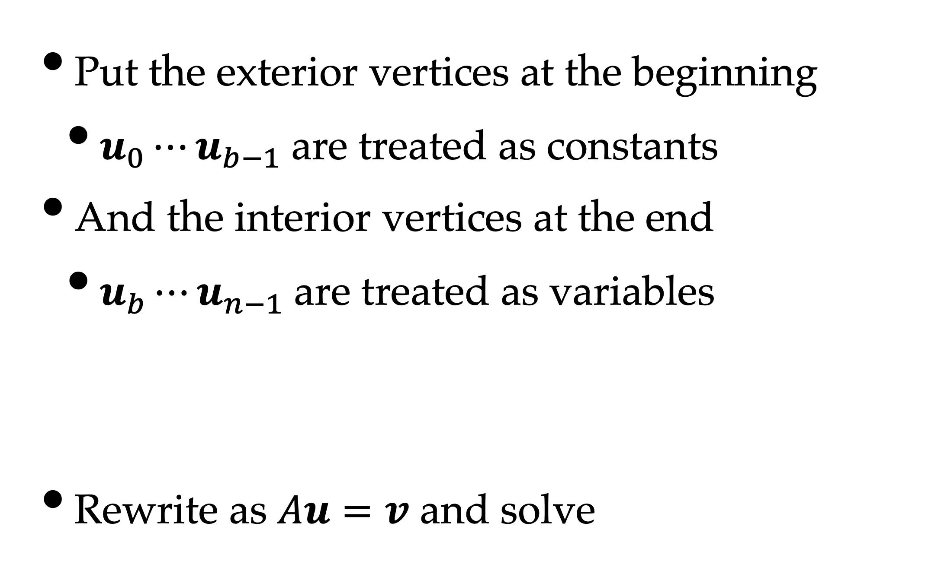
Interior / Exterior Vertices
Put the exterior vertices at the beginning
$u_{0}⋯u_{b−1}$are treated as constants
And the interior vertices at the end
$u_{b}⋯u_{n−1}$are treated as variables
Rewrite as $Au=v$ and solve
For all i≥b
$$\sum_{j=b}^{n−1}{a_{ij}u_{j}}=−\sum_{j=0}^{b−1}{a_{ij}u_{j}}$$

Slide 14
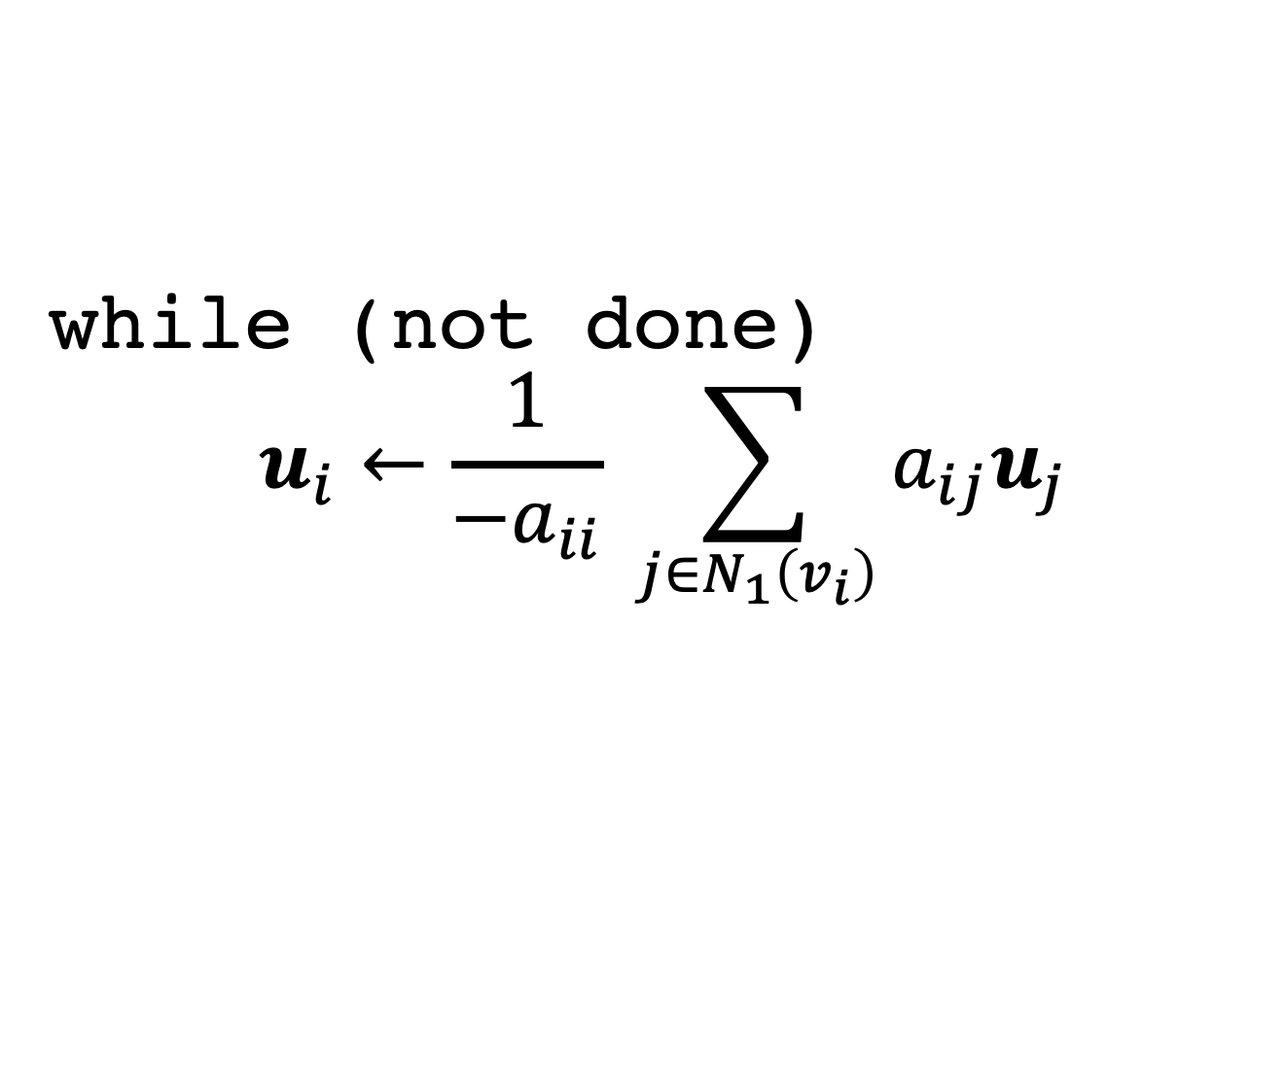
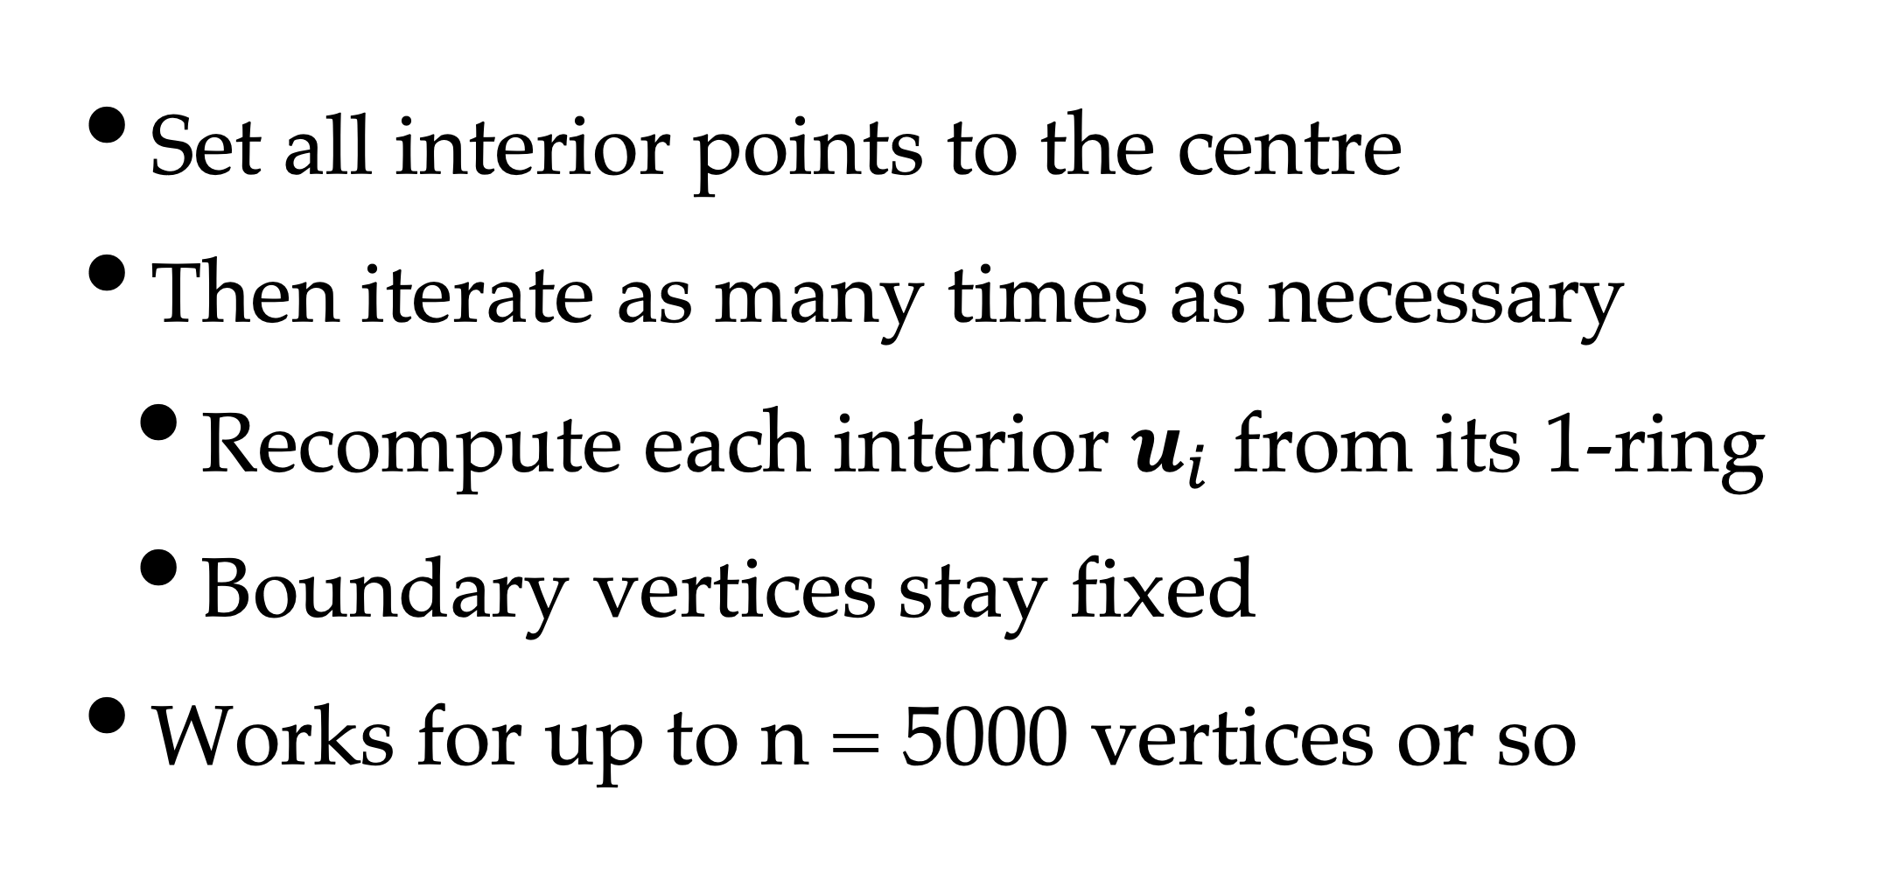
Shortcut
Set all interior points to the centre
Then iterate as many times as necessary
Recompute each interior $u_{i}$ from its 1-ring
Boundary vertices stay fixed
Works for up to n = 5000 vertices or so
while (not done)
$$u_{i}←\frac{1}{−a_{ii}} \sum_{j∈N_{1}\left(v_{i}\right)}^{ }{a_{ij}u_{j}}$$

Slide 15
Result
Hormann, 2007 ACM (via Botsch et al.)
Works well, but distorts texture

Slide 16
Weight Choices
Uniform weights cause this distortion
Cotangent weights can be negative
Unless you guarantee no triangles are obtuse
Or you subdivide
Or you add another hack
Such as triangle area or perimeter angle

Slide 17
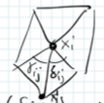
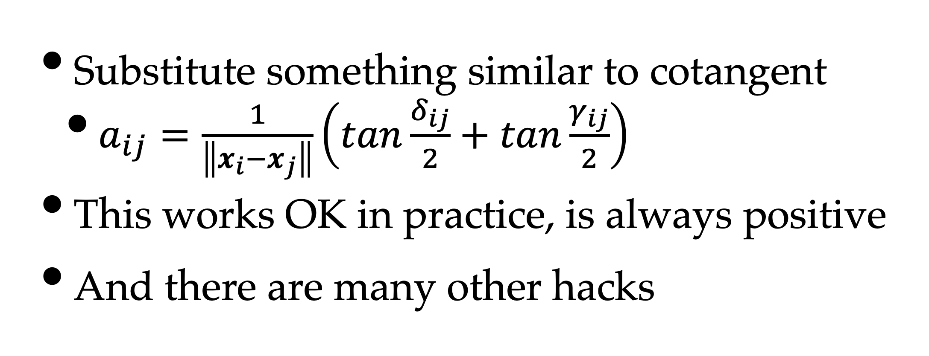
Floater, 2003
Substitute something similar to cotangent
$a_{ij}=\frac{1}{\left\|x_{i}−x_{j}\right\|}\left(tan\frac{δ_{ij}}{2}+tan\frac{γ_{ij}}{2}\right)$
This works OK in practice, is always positive
And there are many other hacks

Slide 18
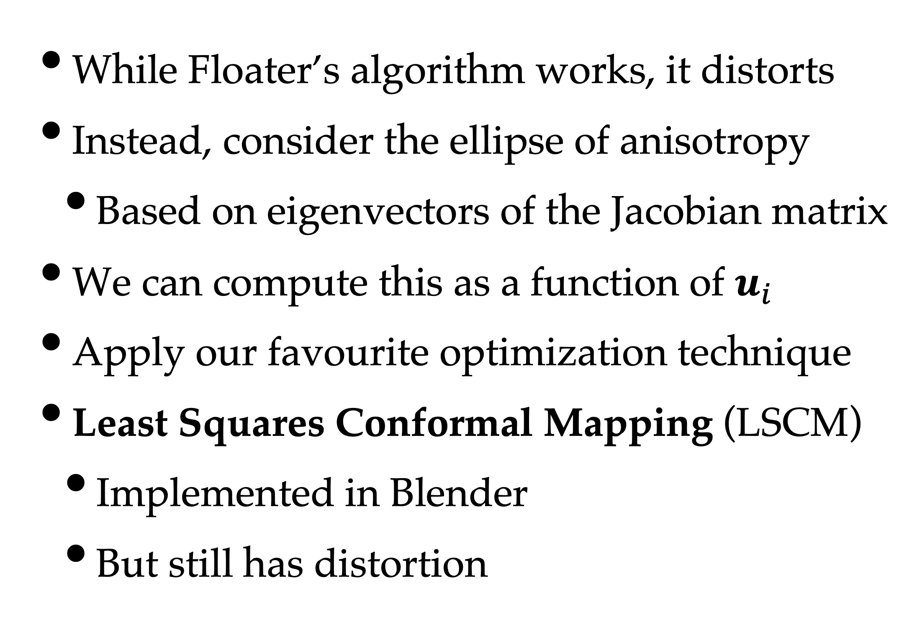
Problems
While Floater’s algorithm works, it distorts
Instead, consider the ellipse of anisotropy
Based on eigenvectors of the Jacobian matrix
We can compute this as a function of $u_{i}$
Apply our favourite optimization technique
Least Squares Conformal Mapping (LSCM)
Implemented in Blender
But still has distortion

Slide 19
Texture Synthesis
Given a mesh M with
Vertex positions P
Texture coordinates U
Attribute values A
Render M in 2D
Using U as vertex positions, not P
And the texture will hold the attribute

Slide 20
Deformation & Morphing
Two related problems
Deformation – used for modelling
Morphing – used for animation
Both require mapping x,y,z meshes to u,v
But not necessarily u,v you start with

Slide 21
Deformation Modelling
Artist “grabs” a point on a surface
We need to discuss how to do this
And drags it to modify shape
So, given (x,y) in screen space
Find corresponding (u,v) in texture space
And find closest vertex to drag

Slide 22
Picking Points in 3D
Raytrace & find intersection (slow)
Specialised render code (no-one uses this)
Back-buffer hack:
Render in false colour (u,v -> RGB)
Read the pixel under the mouse
Now you know the u,v coordinates

Slide 23
Deformation
We’ve found a vertex
What direction do we drag?
Perpendicular to surface
Typically also affects 1-ring or 2-ring
Sometimes a circular area in texture cords
How much do they move?
Gaussian weighting based on distance

Slide 24
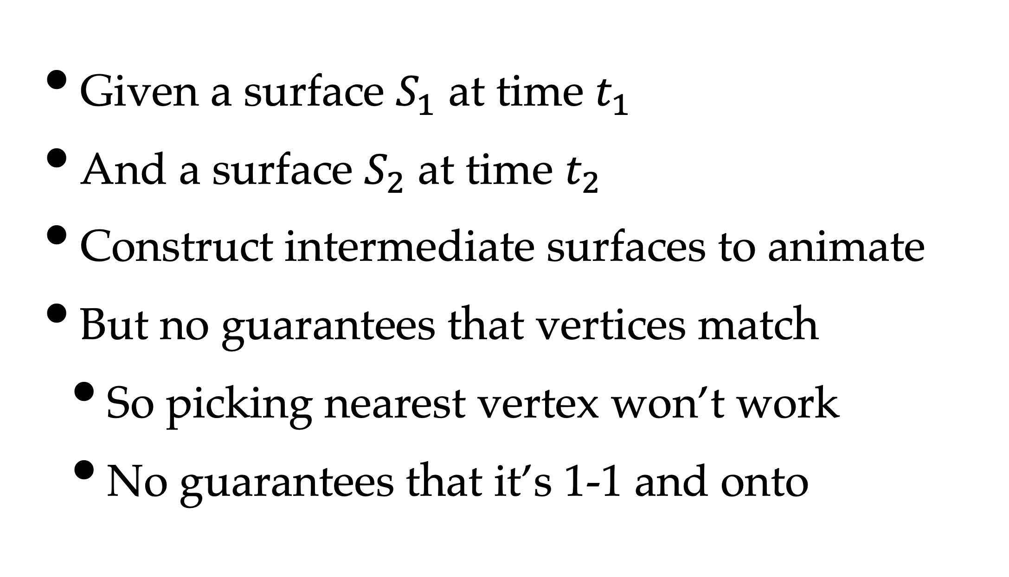
Morphing
Given a surface $S_{1}$ at time $t_{1}$
And a surface $S_{2}$ at time $t_{2}$
Construct intermediate surfaces to animate
But no guarantees that vertices match
So picking nearest vertex won’t work
No guarantees that it’s 1-1 and onto

Slide 25
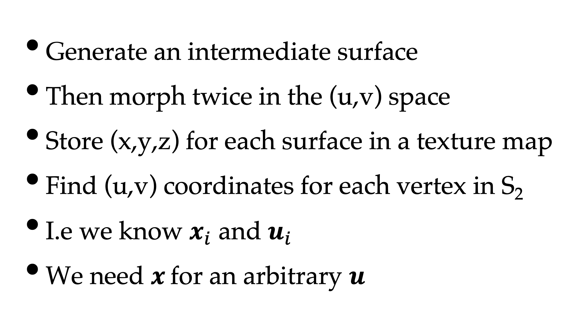
Solution
Generate an intermediate surface
Then morph twice in the (u,v) space
Store (x,y,z) for each surface in a texture map
Find (u,v) coordinates for each vertex in S₂
I.e we know $x_{i}$ and $u_{i}$
We need $x_{ }$for an arbitrary $u$

Slide 26
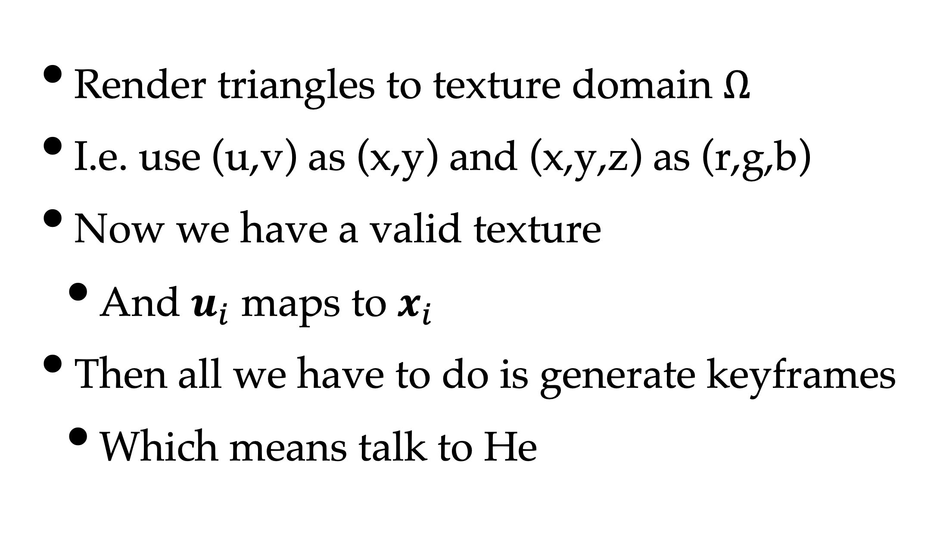
Rasterise to Texture
Render triangles to texture domain $Ω$
I.e. use (u,v) as (x,y) and (x,y,z) as (r,g,b)
Now we have a valid texture
And $u_{i}$ maps to $x_{i}$
Then all we have to do is generate keyframes
Which means talk to He

Slide 27
Intermediate Surface
Generate a distance field
Choose the medial axis (half-way points)
{Artist, Algorithm} chooses a correspondence
By identifying landmarks / features
And pairing them up
Many, many hacks & heuristics

